Slide 1

Birchenall’s Correlation
Anirudh Bali, Robert Beatty, Jay Patel
Department of Mechanical and Materials Engineering
University of Cincinnati
03.23.2026

Slide 2
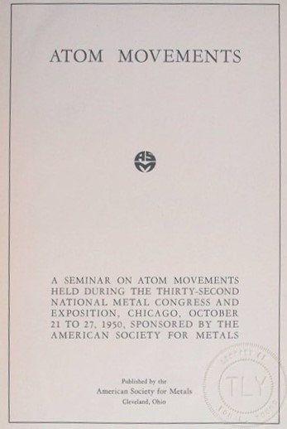
Overview & Historical Background
Birchenall’s Correlations
Volume Diffusion – An Empirical Survey, 1951
Objectives:
Compile results of diffusion experiments
Report qualitative correlations found in the data
Identify where additional data would be useful
Empirical Trends Considered: (1) structure dependence, (2) temperature dependence, (3) concentration dependence
Historical Context
Prepared for a seminar on the movement of atoms held by the American Society of Metals (ASM) in 1950
Organized to discuss the current understanding of diffusion mechanisms
Lecture Topics: (1) phenomenological description of diffusion, (2) mechanisms of diffusion, (3) methods for obtaining, analyzing, and presenting diffusion data, (4) analysis of diffusion data
Notable Participants: L.S. Darken, H.B. Huntington, C.E. Birchenall, R. F. Mehl

Slide 3
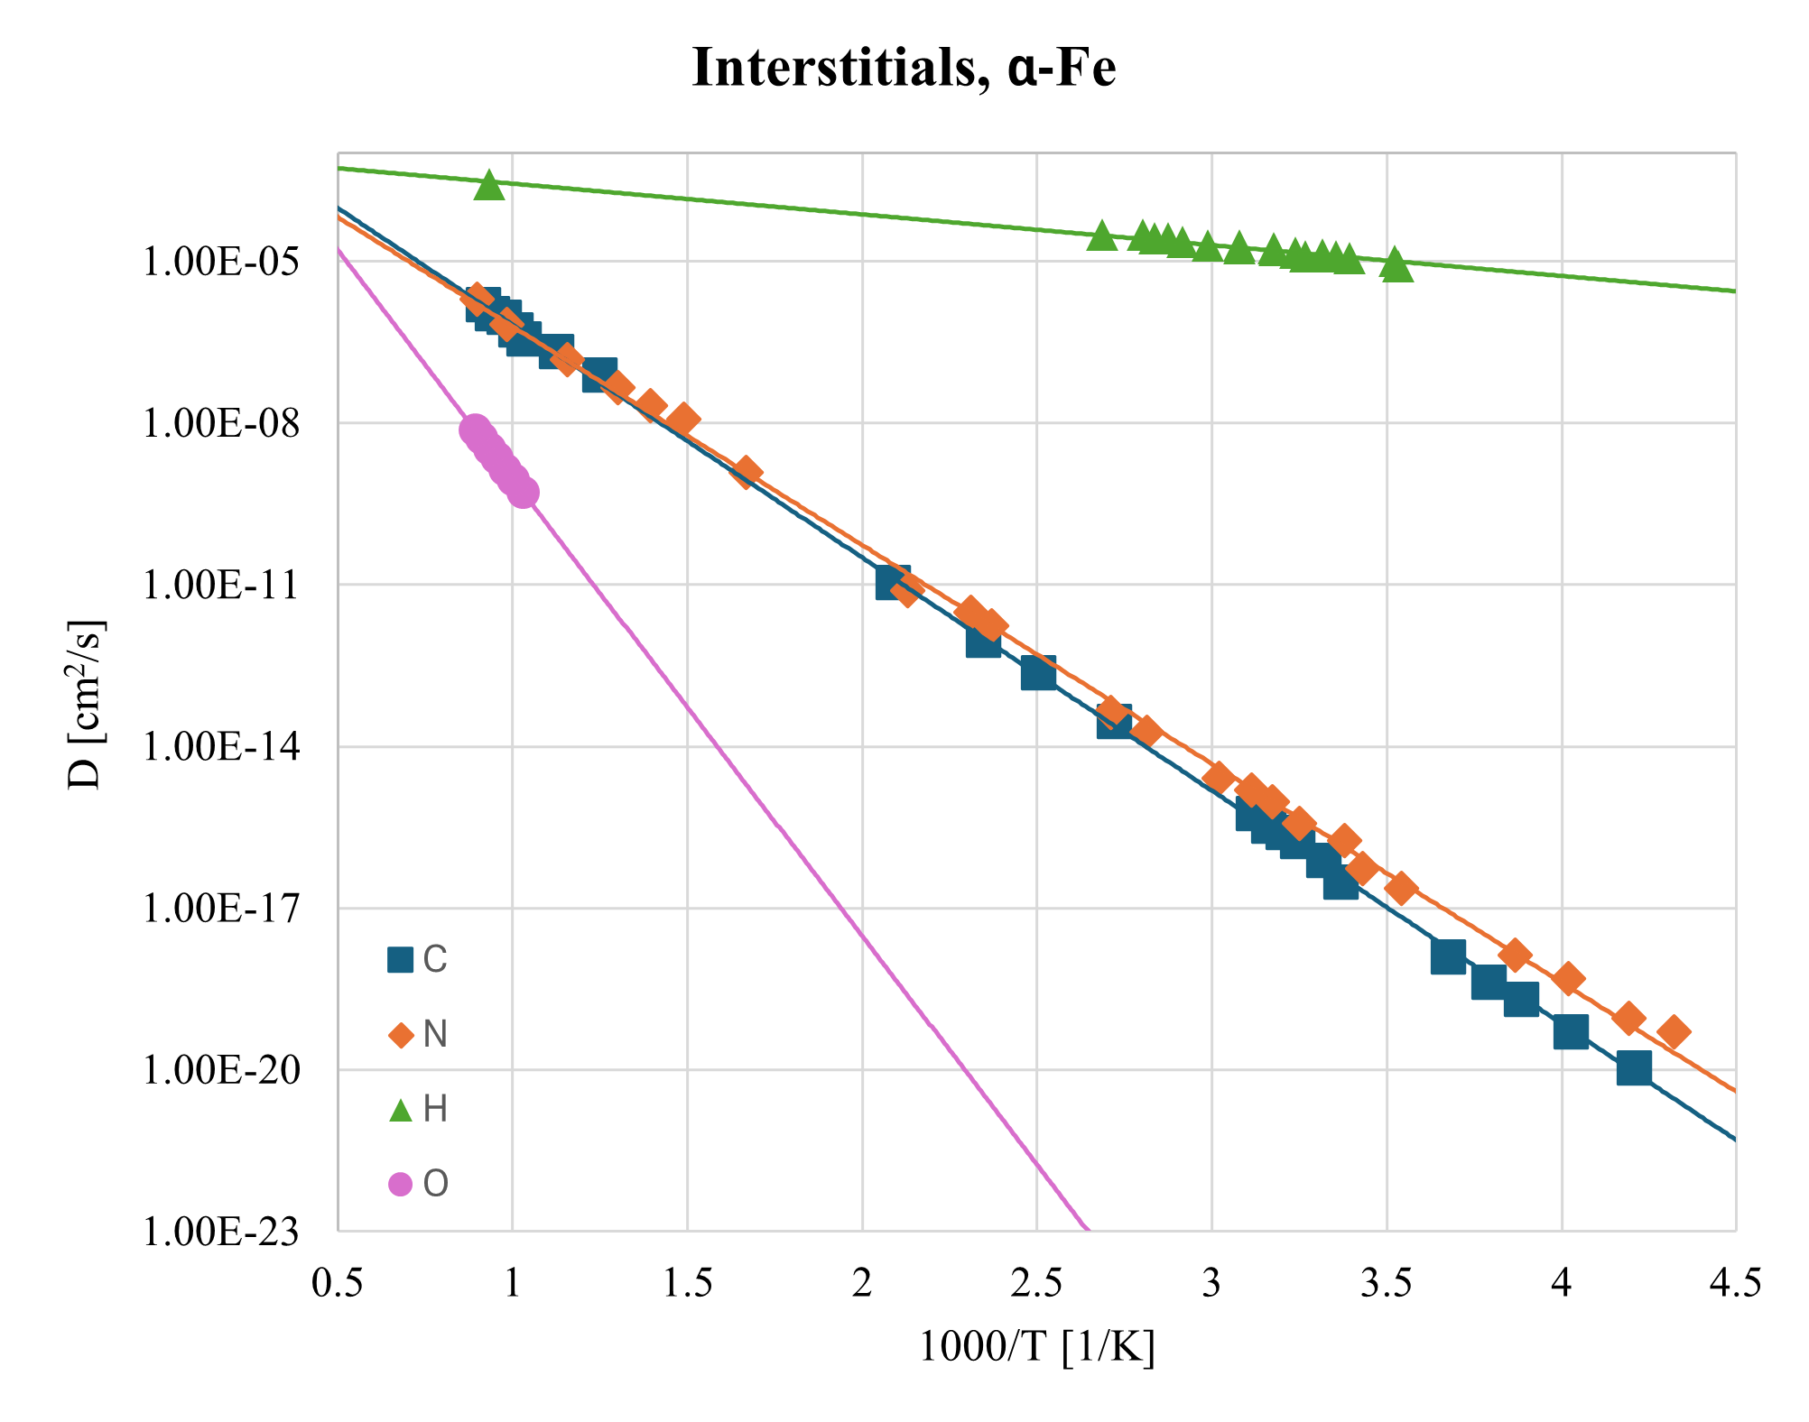
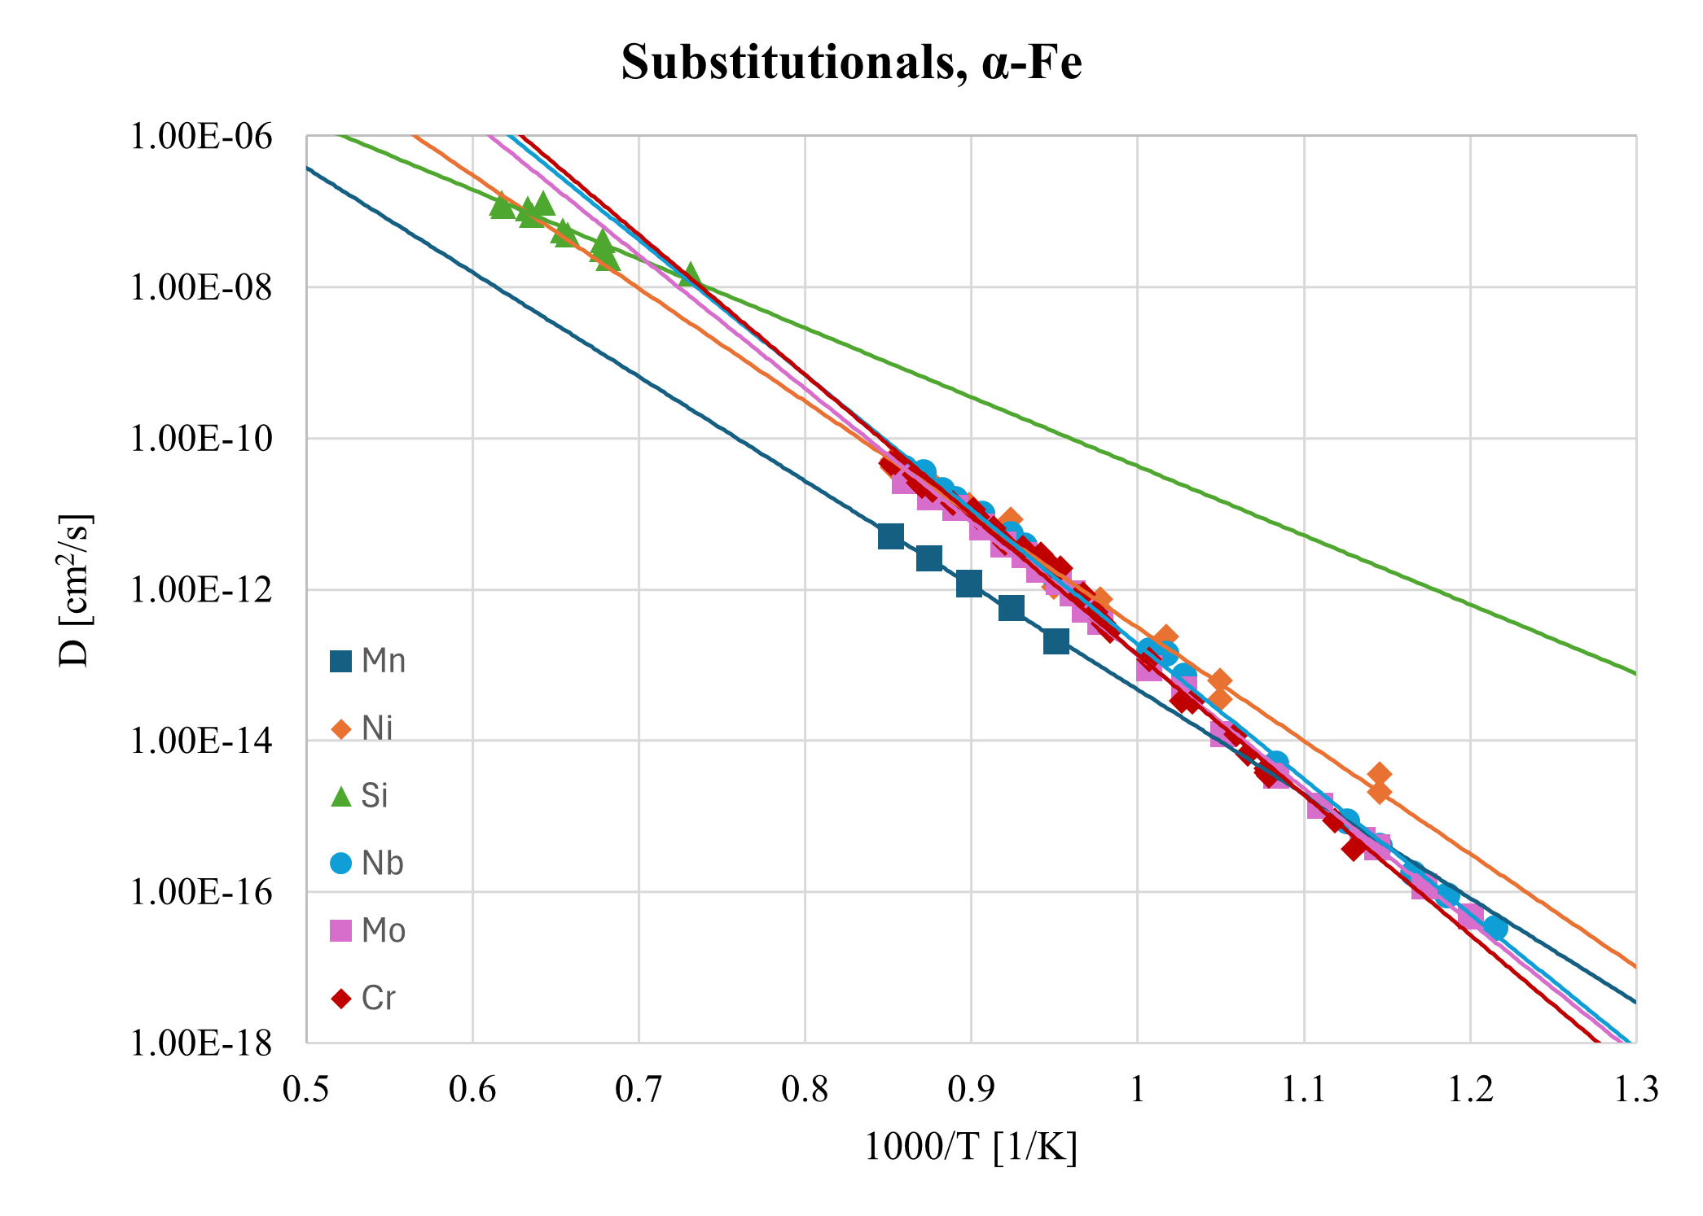
Let’s consider diffusion in α-Fe...

Slide 4
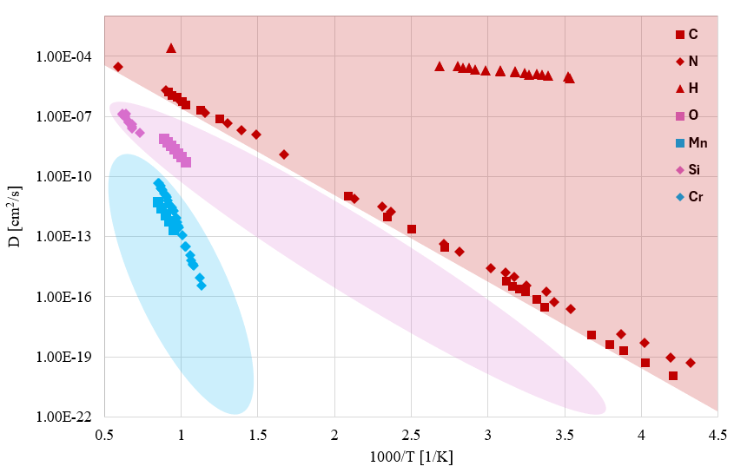
Diffusion in α-Fe
Interstitials
Substitutional

Slide 5
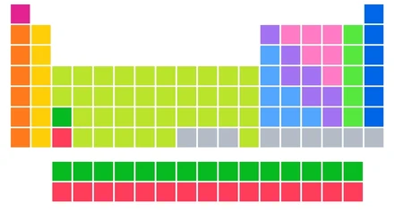
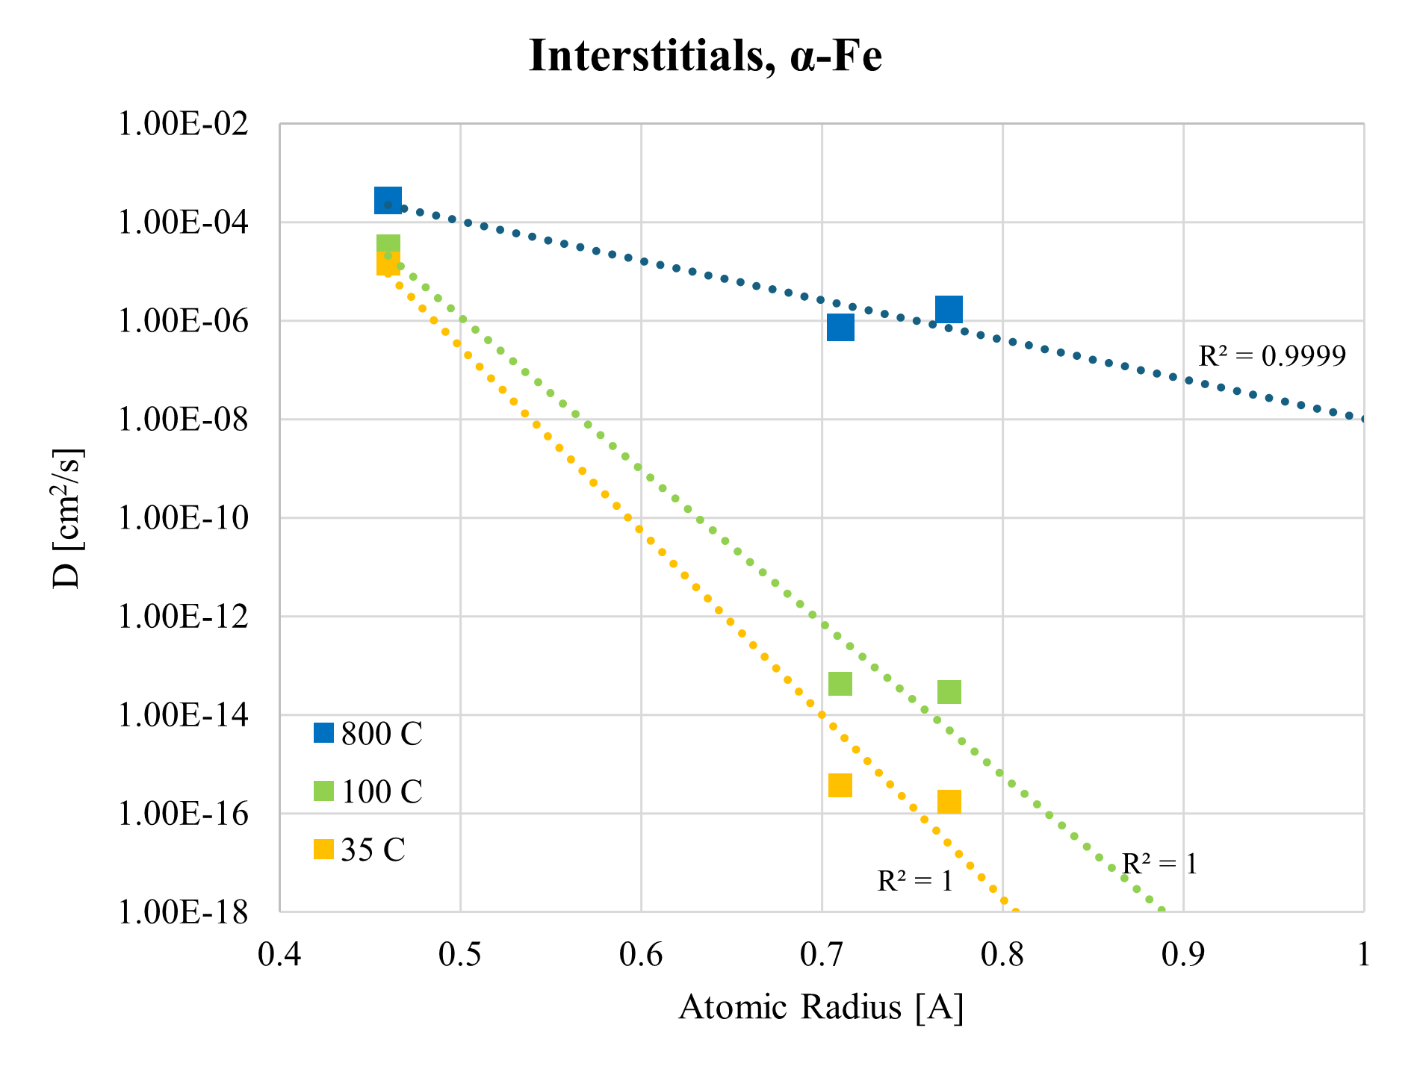
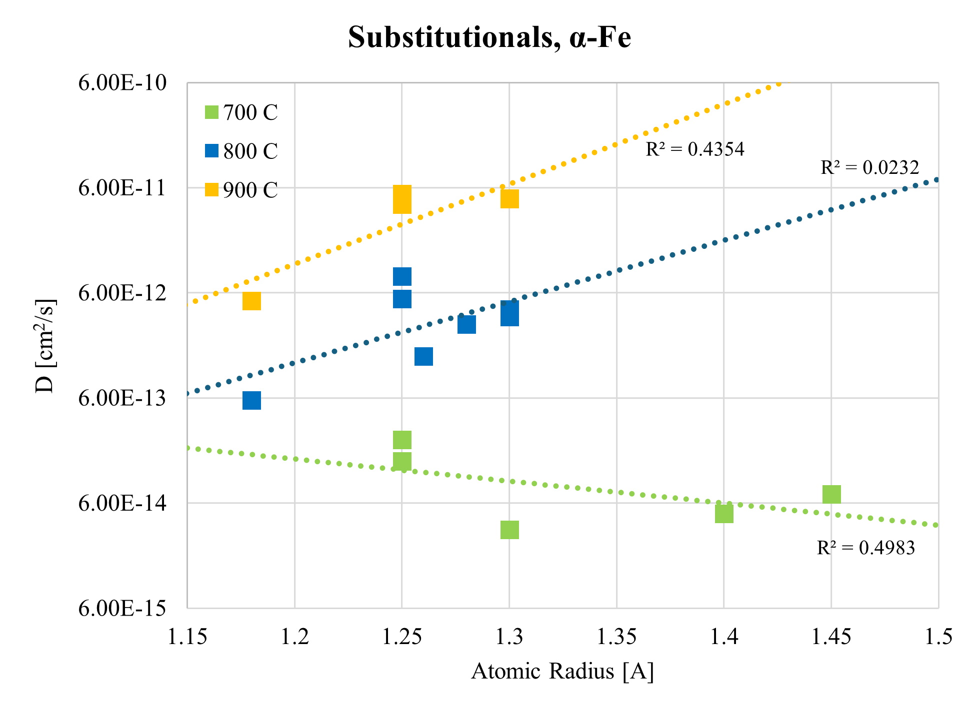

Structure Dependence
$$+ r$$

Slide 6
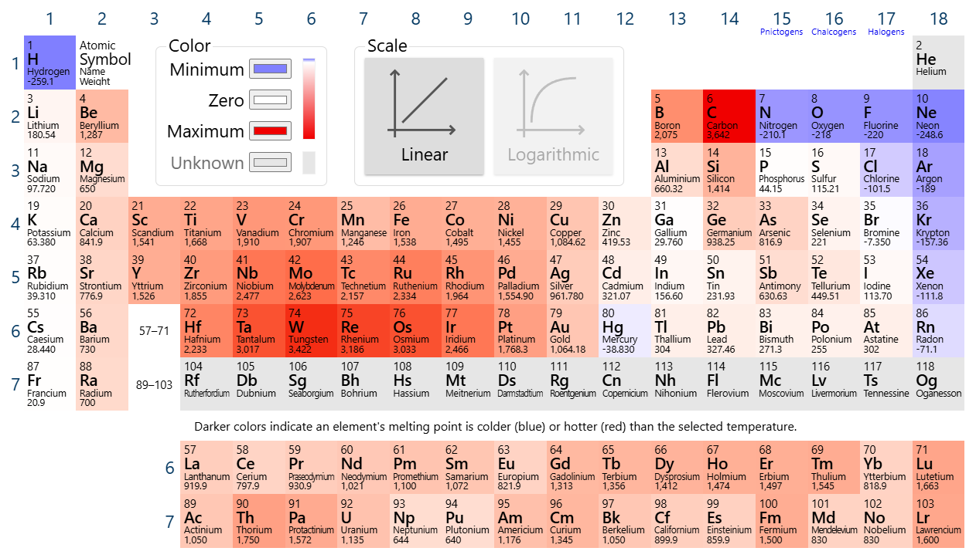
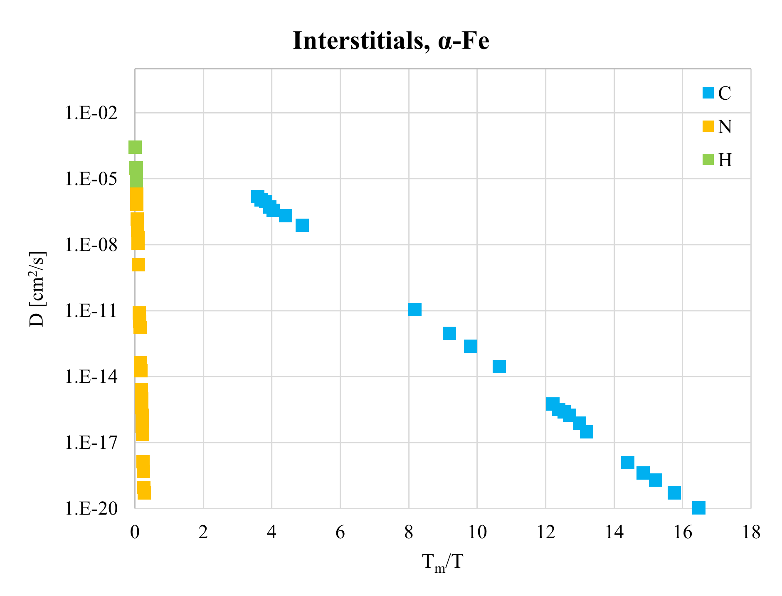
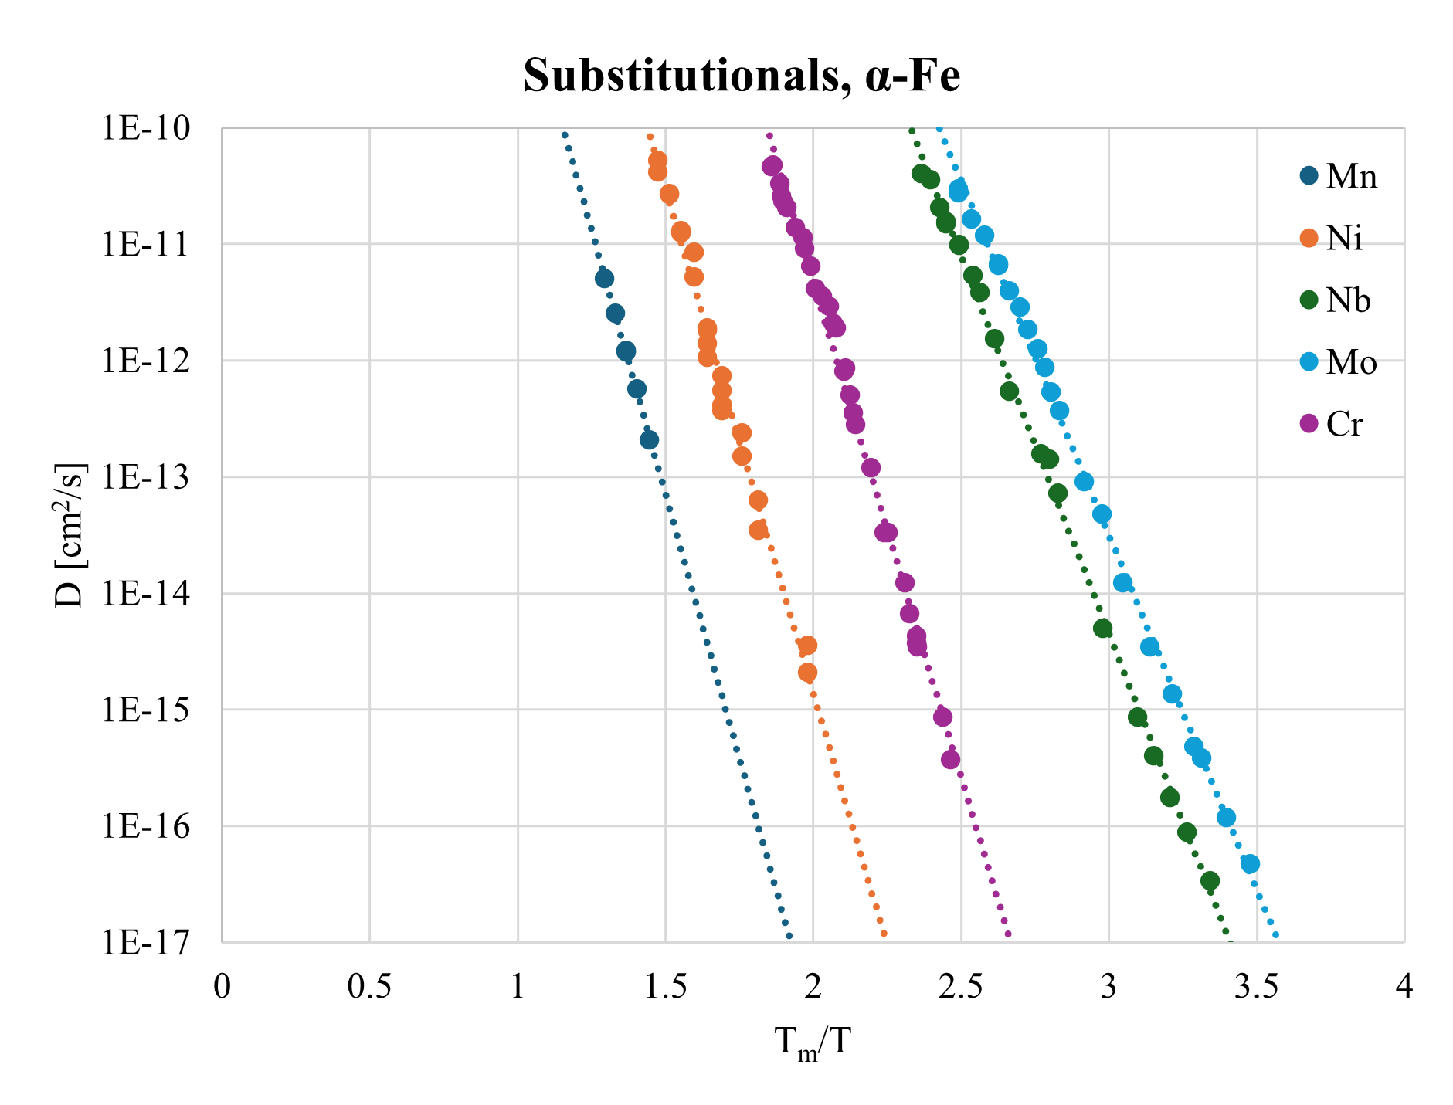
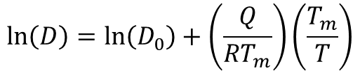



Temperature Dependence
$$\ln\left(D\right)=\ln\left(D_{0}\right)+\frac{Q}{RT}$$
$$\ln\left(D\right)=\ln\left(D_{0}\right)+\left(\frac{Q}{RT_{m}}\right)\left(\frac{T_{m}}{T}\right)$$
$$Is \frac{Q}{T_{m}} constant?$$
$$\frac{Q}{RT_{m}}=−17.88 ±20\%$$

Slide 7
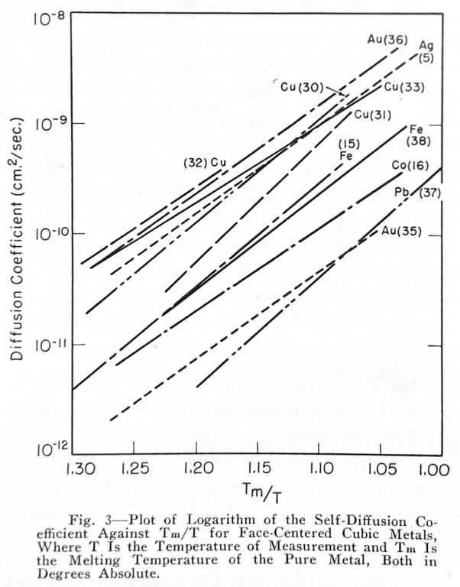
Temperature Dependence

Slide 8
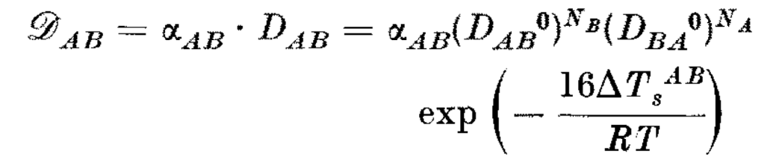
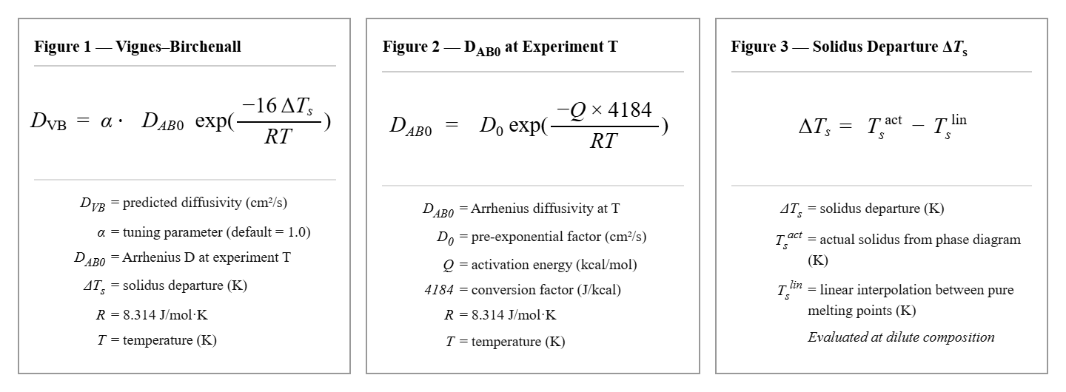
Quantifying Birchenall’s Correlations
The Vignes-Birchenall Correlation was simplified for this project, with some assumptions
α = 1 for all elements
N_{A}= 0 Dilute Solute Assumption
ΔTs is read at the dilute limit

Slide 9
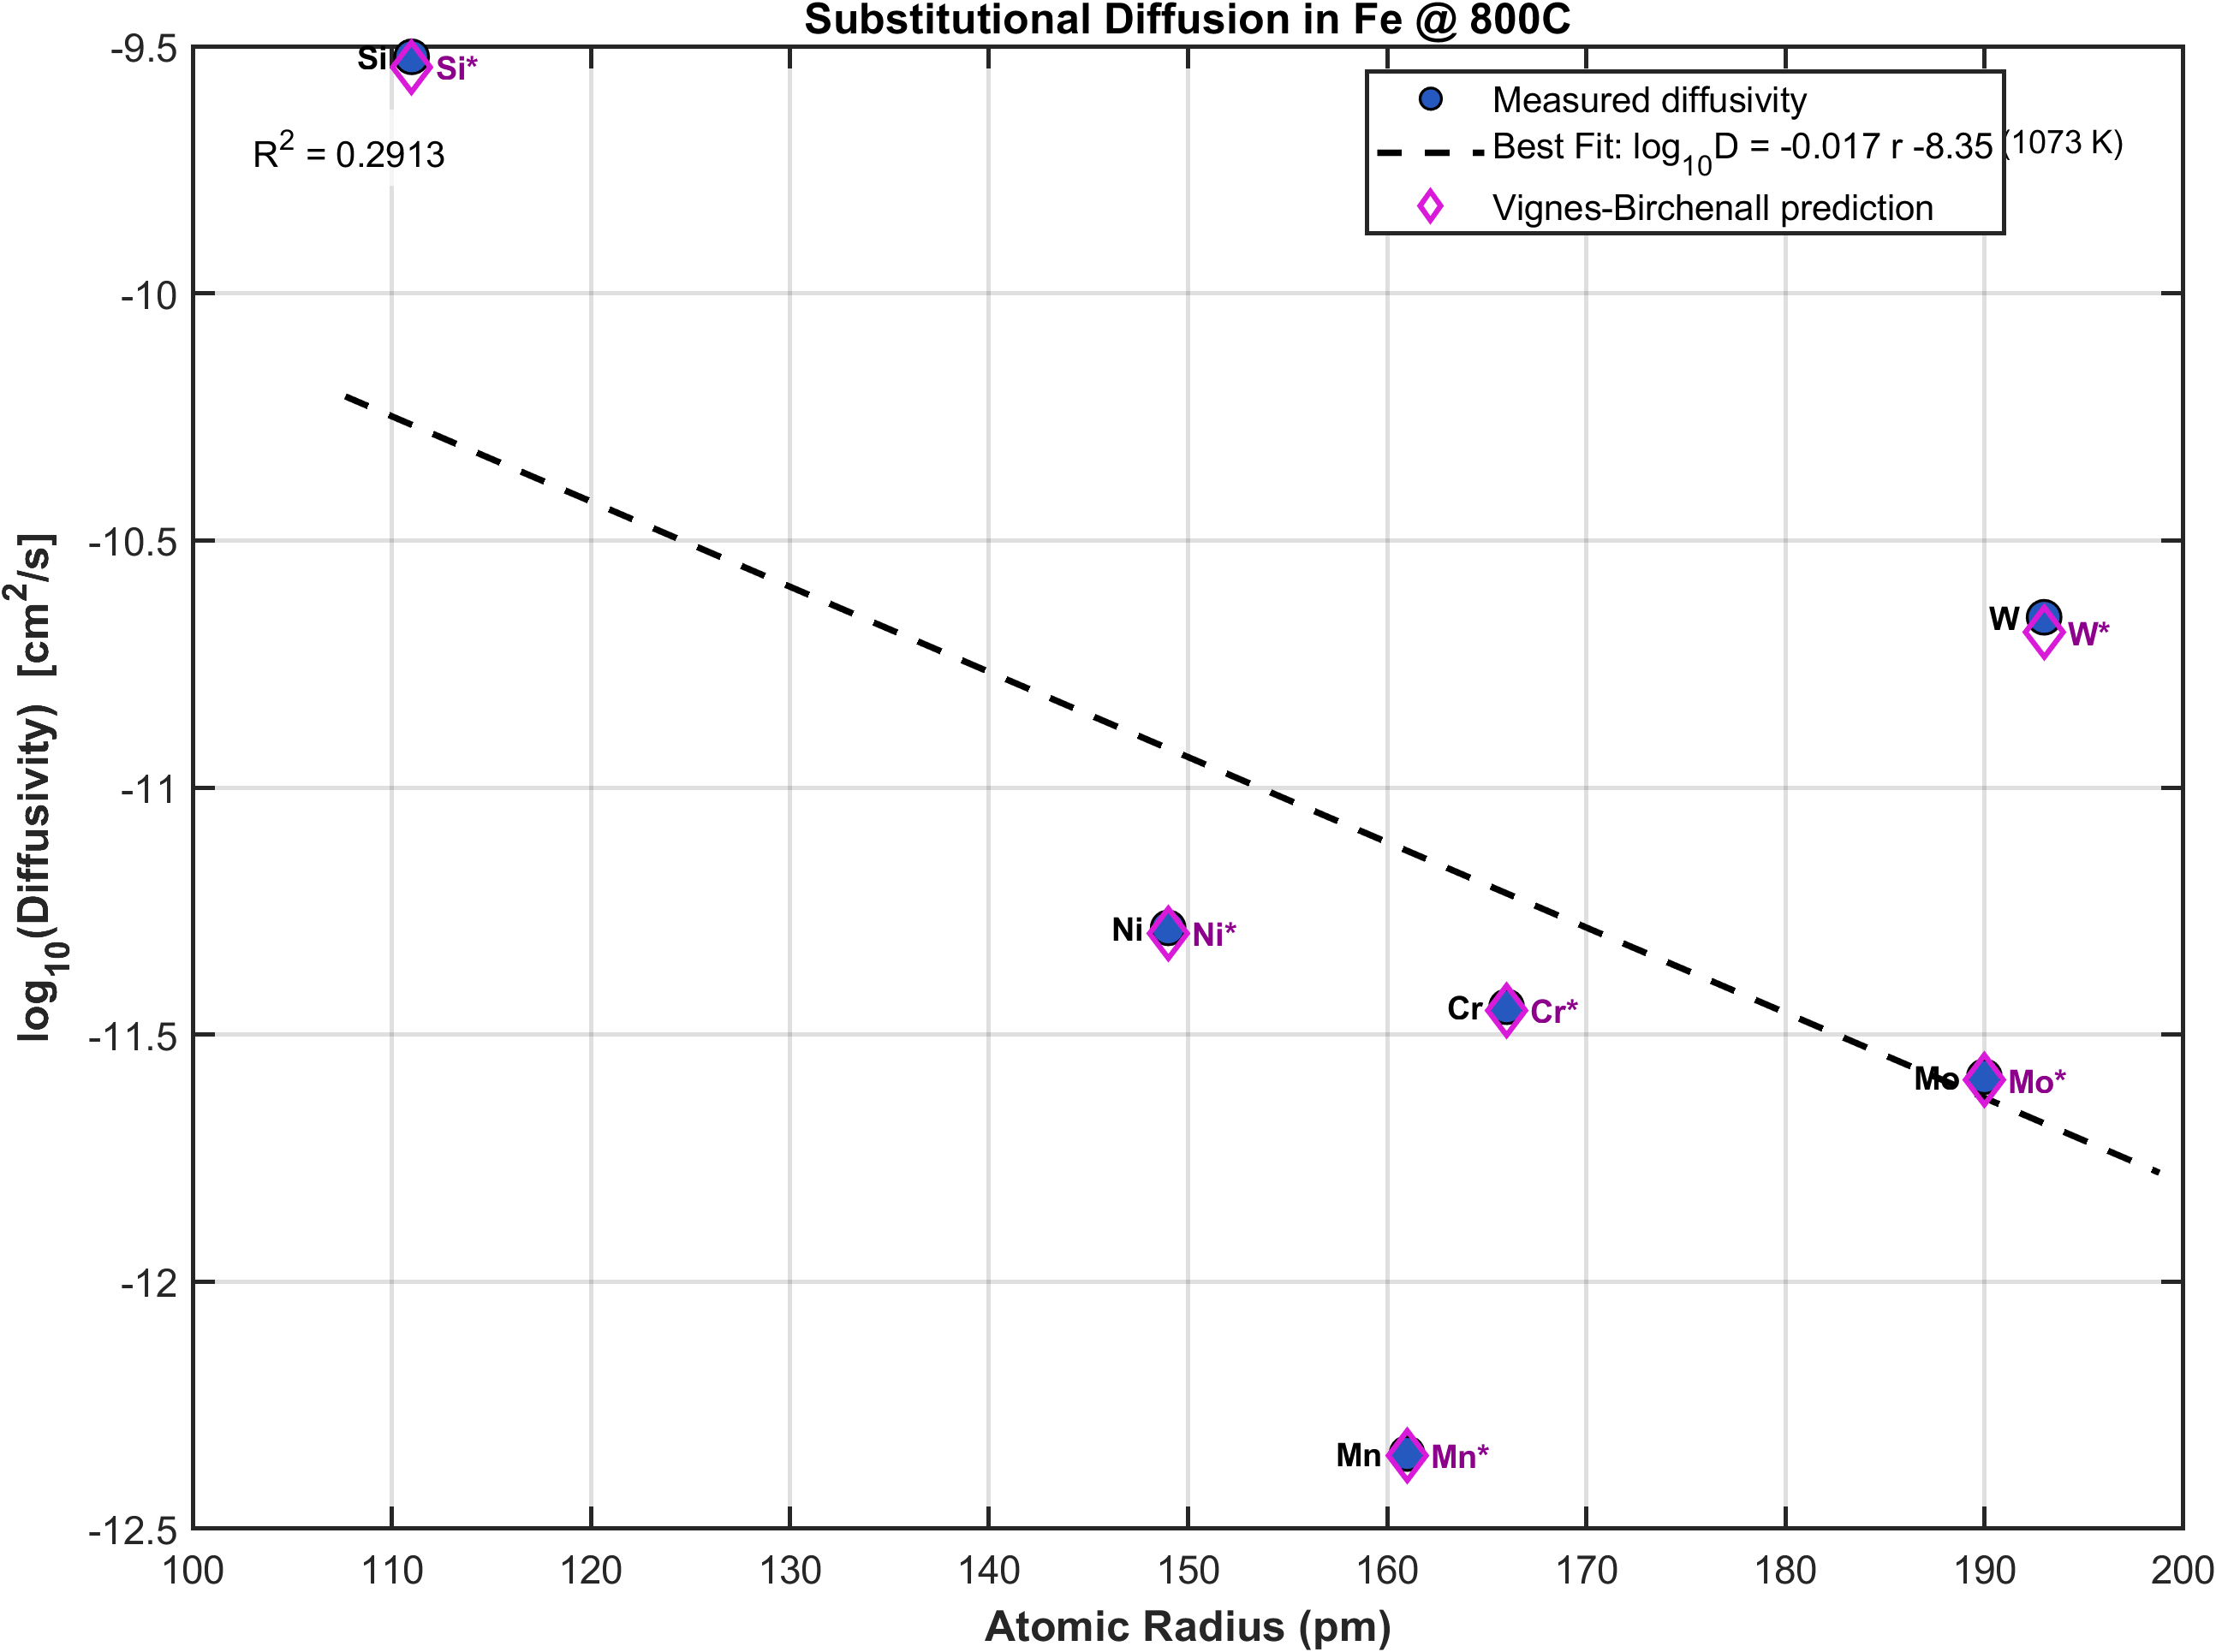
Diffusion in α-Fe at 1100 °C
Fe is a prime example for the VB correlation
The crystal structure is much tighter, BCC, with an interstitial site 19 pm across
In Si, diamond cubic structure, with interstitial site 117 pm across
Oxygen is not a traditional interstitial
Very small (48 pm)
Strong affinity to ionically bond with Fe fundamentally changes local structure
Requires high activation energy to be dislodged

Slide 10
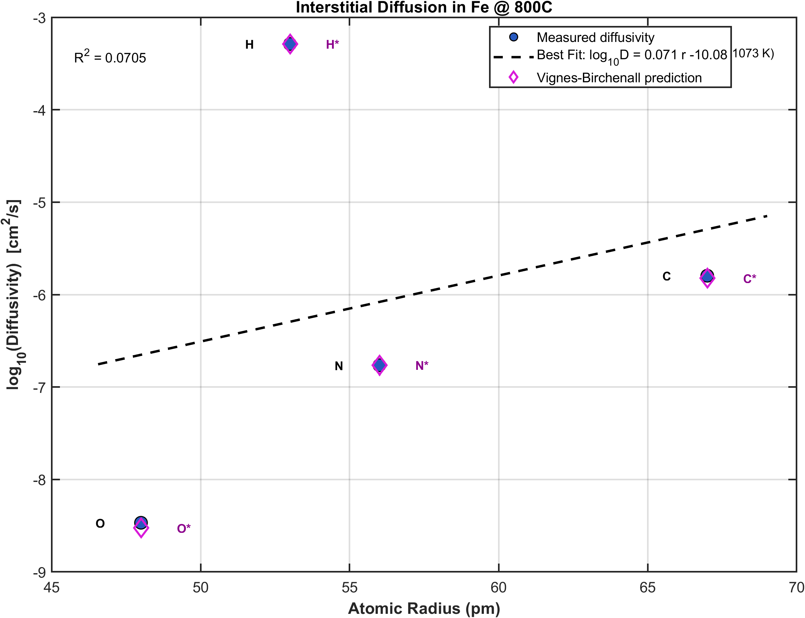
Diffusion in α-Fe at 1100 °C
Fe is a prime example for the VB correlation
The crystal structure is much tighter, BCC, with an interstitial site 19 pm across
In Si, diamond cubic structure, with interstitial site 117 pm across
Oxygen is not a traditional interstitial
Very small (48 pm)
Strong affinity to ionically bond with Fe fundamentally changes local structure
Requires high activation energy to be dislodged

Slide 11
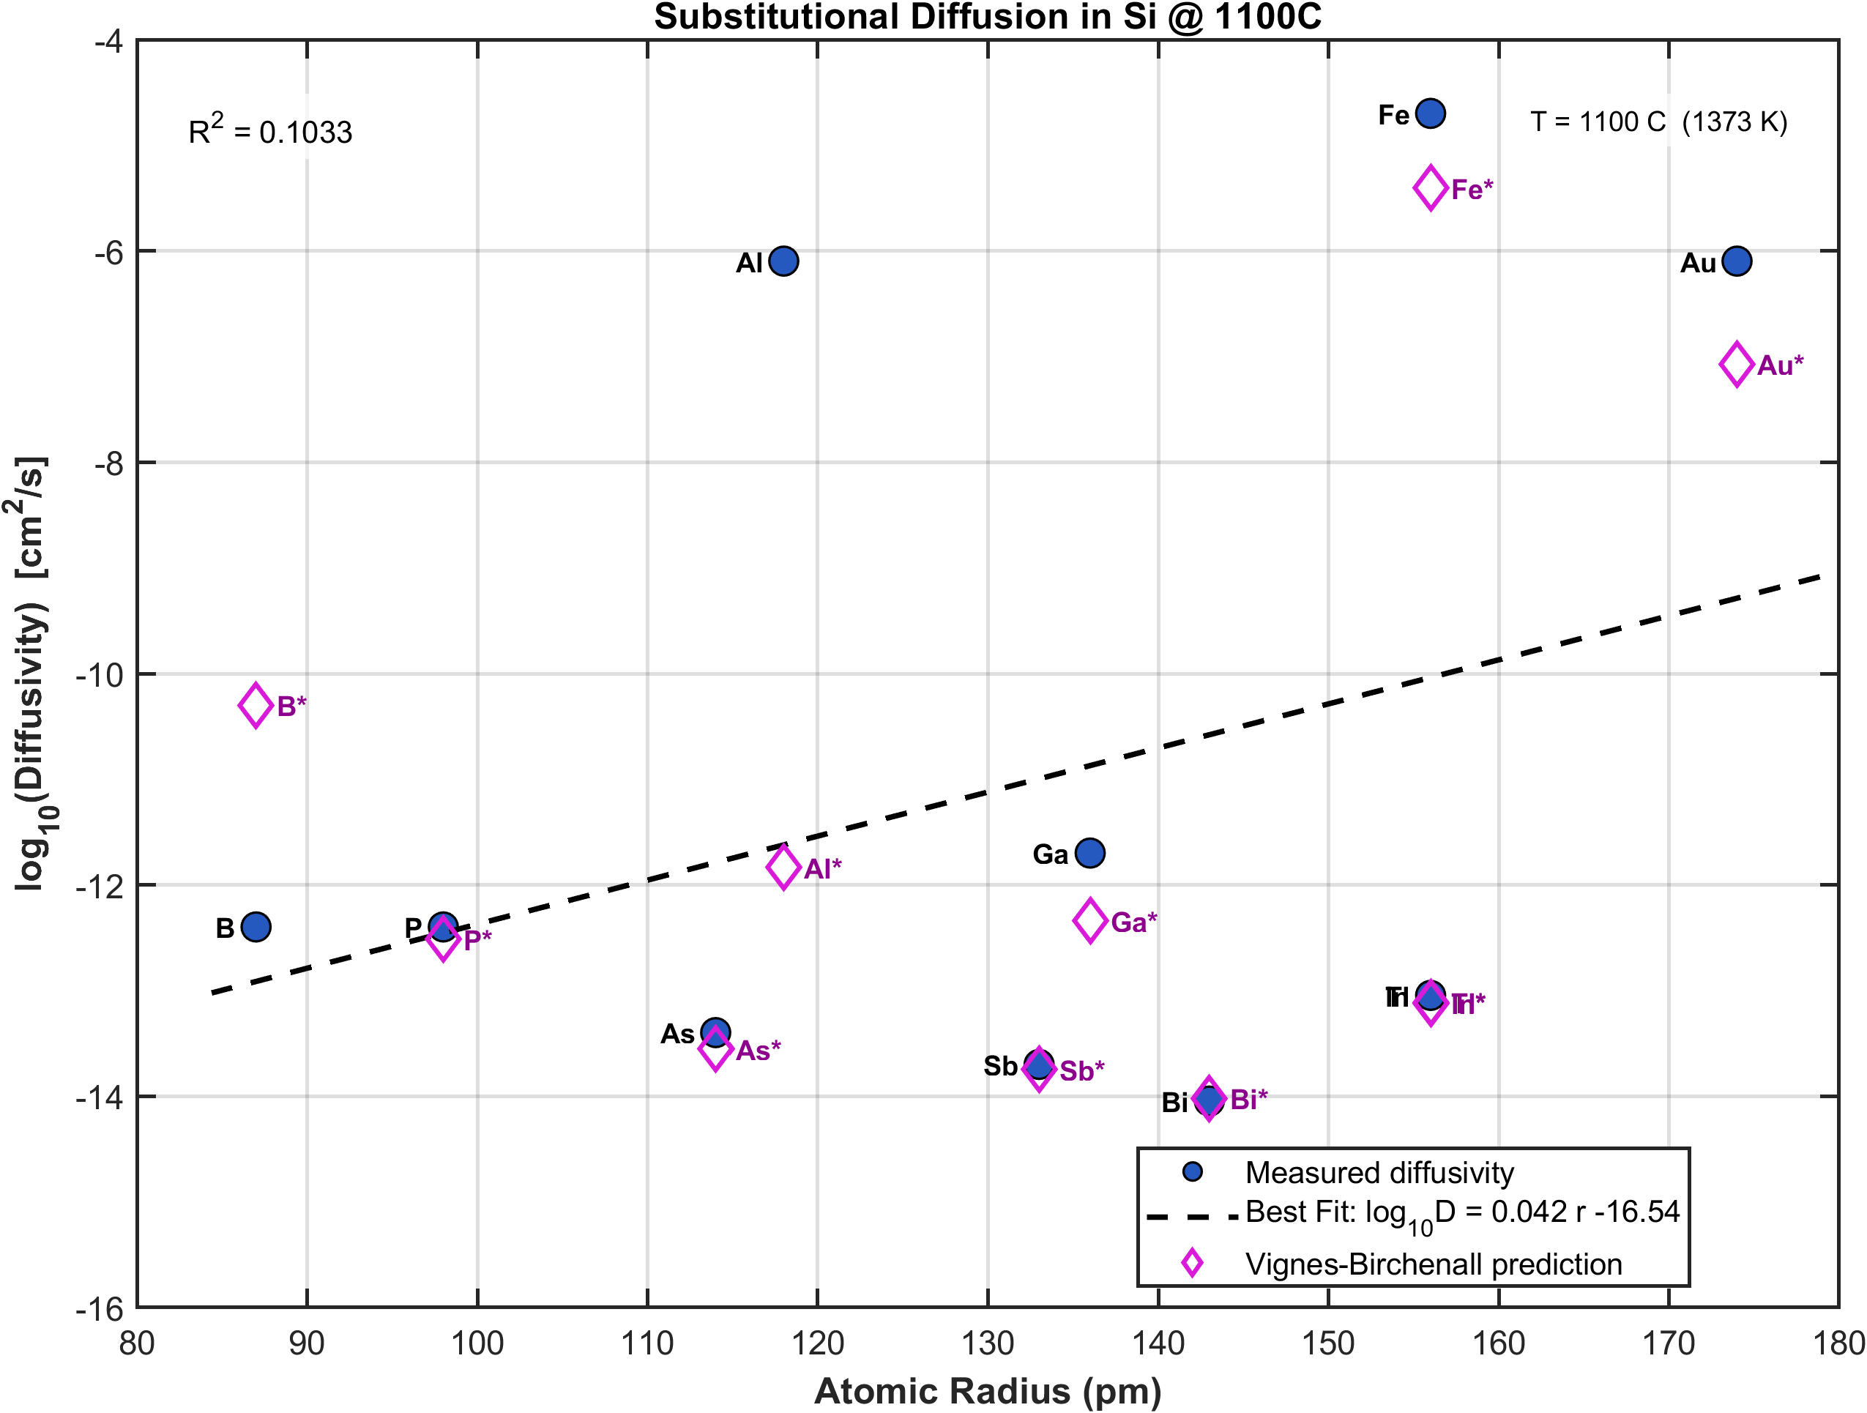
Diffusion in Si at 1100 °C
Group 13 elements like B and Al behave awkwardly
The extra valence electron means they are easily ejected from substitutional sites
They travel the crystal interstitially
Fe, Au, and other transition metals
Kickout Mechanism
Equilibrium population at both interstitial and substitutional sites
Both lead to poor VB agreement with real data

Slide 12
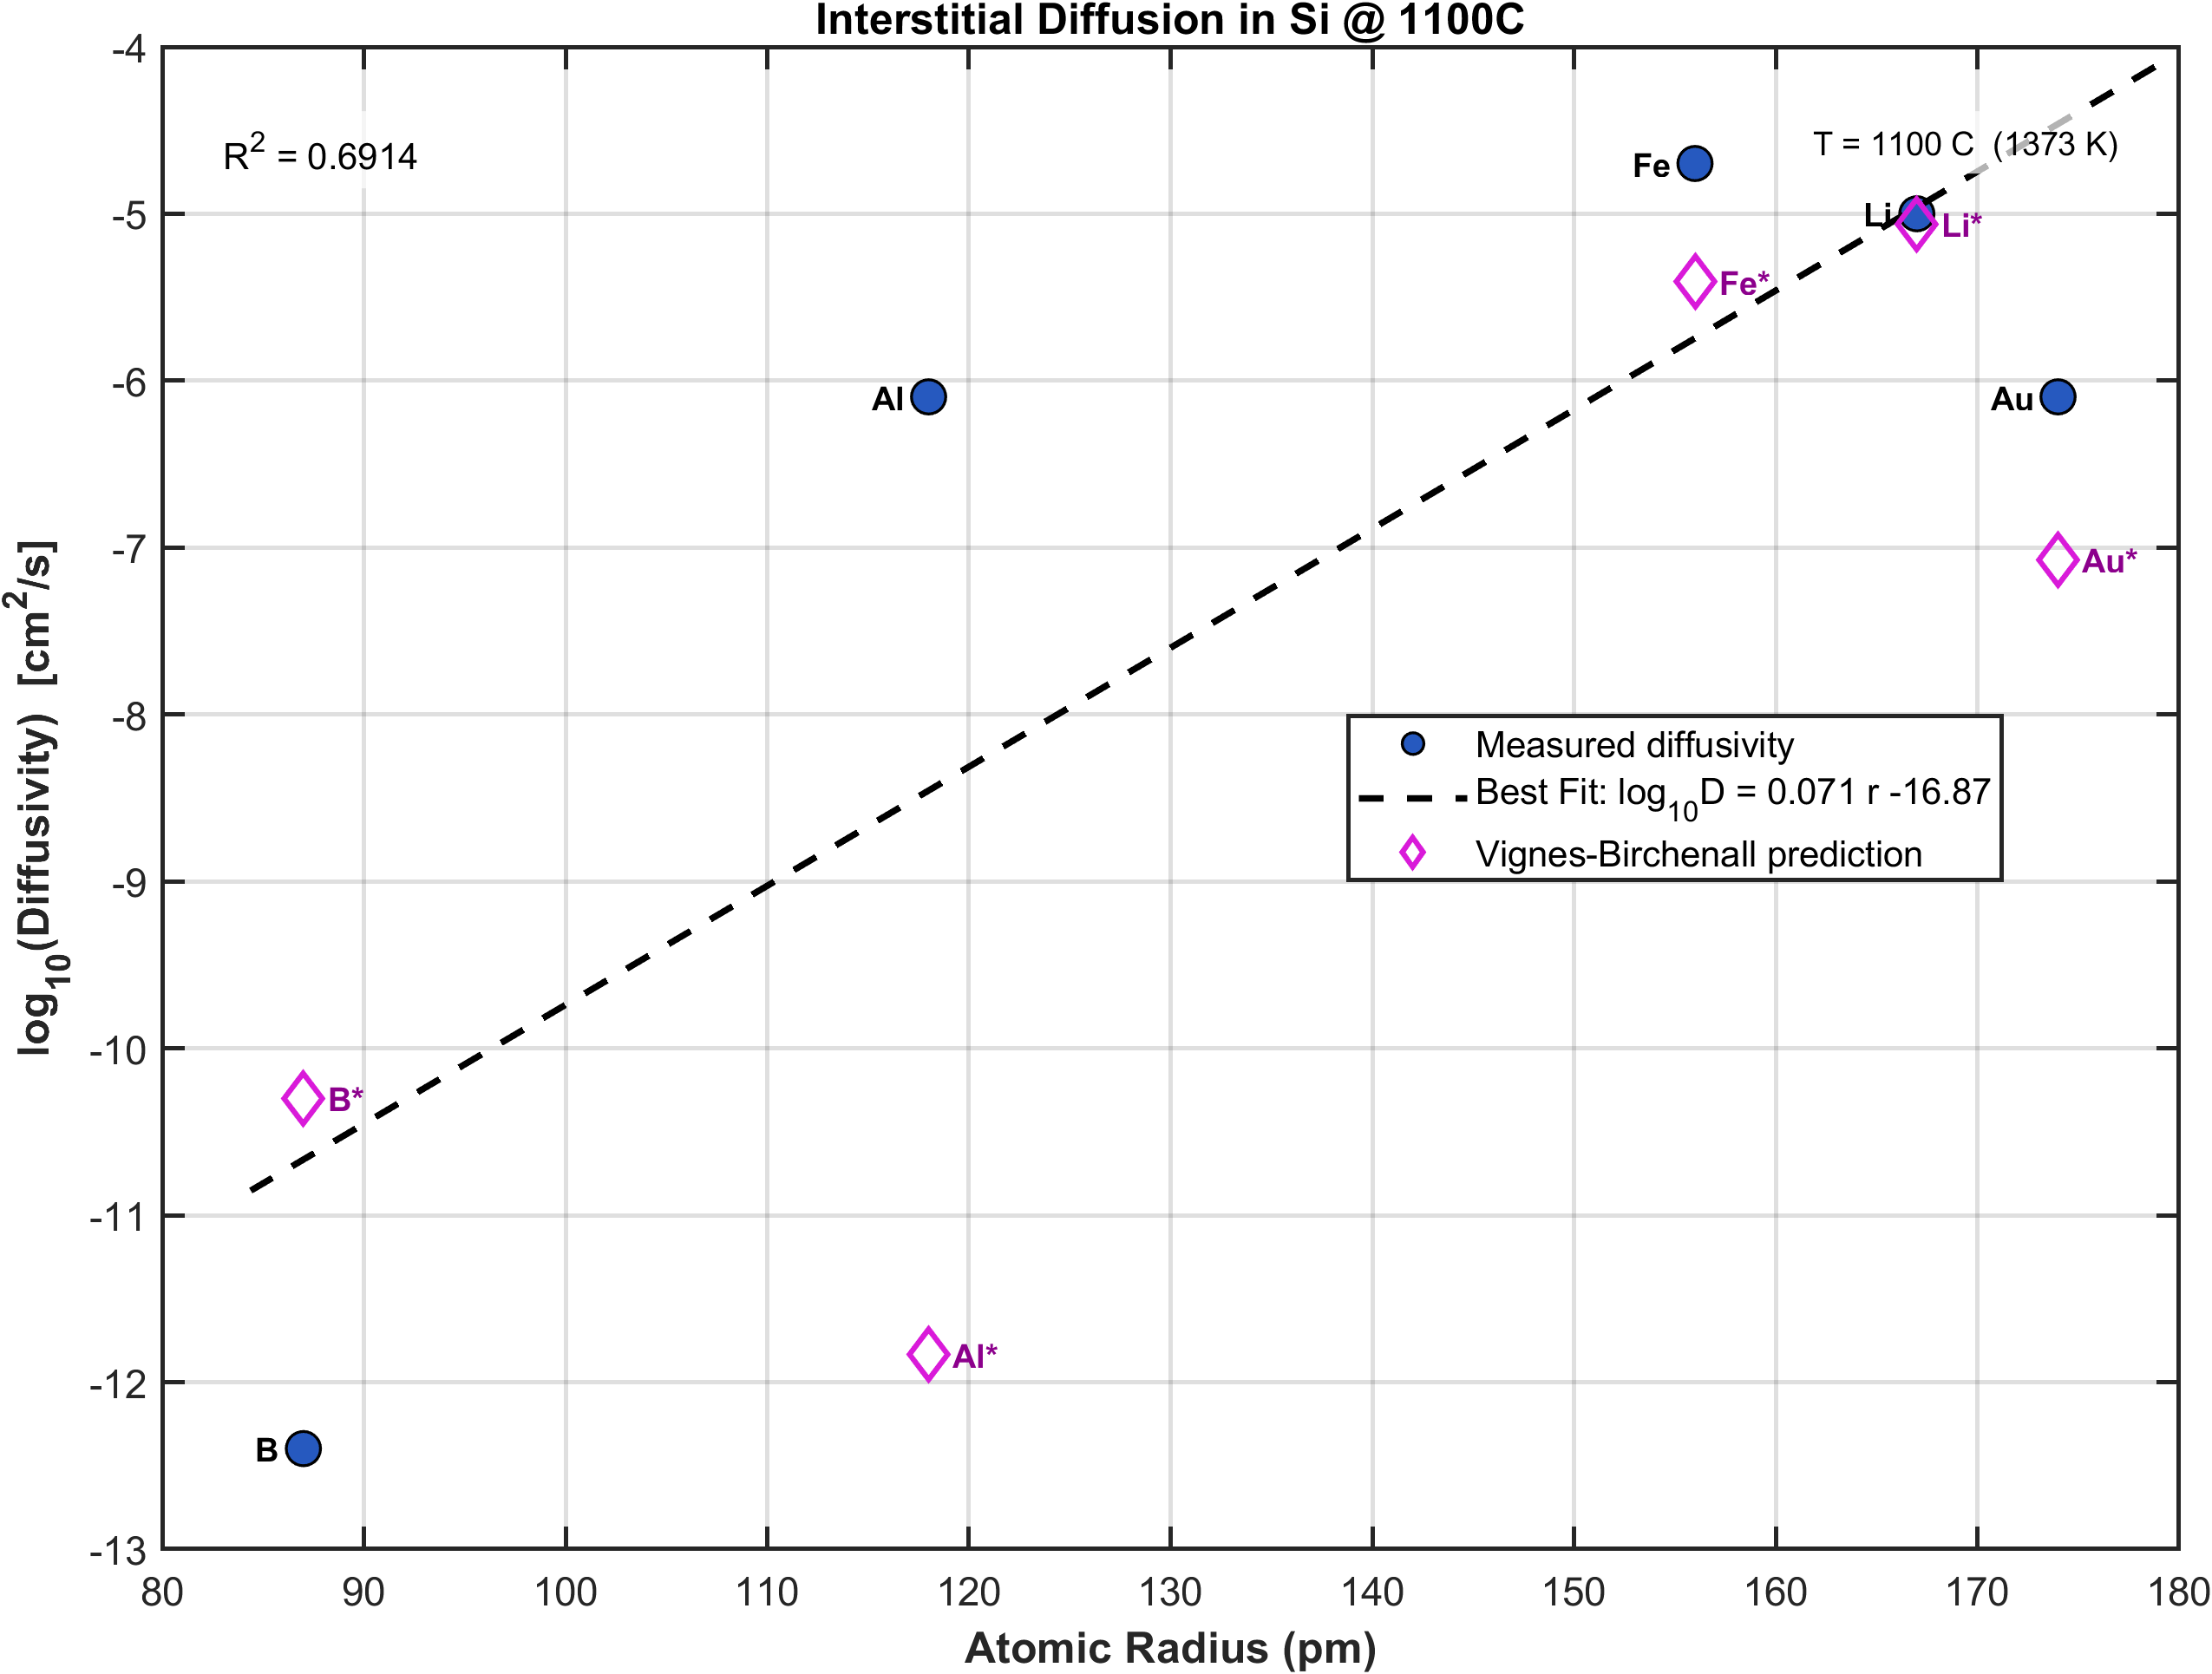
Diffusion in Si at 1100 °C
Group 13 elements like B and Al behave awkwardly
The extra valence electron means they are easily ejected from substitutional sites
They travel the crystal interstitially
Fe, Au, and other transition metals
Kickout Mechanism
Equilibrium population at both interstitial and substitutional sites
Both lead to poor VB agreement with real data

Slide 13
Conclusions
Interstitially dissolved atoms diffuse more rapidly than substitutional atoms
Correlation between atomic radius and diffusion rate is stronger for interstitial than substitutional atoms
Highlights that electronegativity of solute cannot be neglected
Trends mirror Hume-Rothery rules
Activation energies show correlation between melting temperature that are “near” each other

Slide 14
Assessment of Birchenall’s Correlation
Strengths
Qualitative correlations can be used to validate/assess new data or choose between datasets that are inconsistent with each other
Qualitative correlations can support quantitative theories & post theoretical questions
Especially applicable for metallic host systems
Weaknesses
Empirical correlation requires data to validate assumptions
Does not predict diffusivity in non-metals very effectively
Potential Use Cases
Basic alloy design screening
High temperature processing prediction
Extrapolation for poorly studies systems

Slide 15
References
[1]Periodic Table - Ptable. (2024). Ptable.com. https://ptable.com/#Properties
[2] Birchenall, C. E. 1951. “Volume Diffusion – An Empirical Survey.” In Atom Movements: A Seminar on Atom Movements Held During the Thirty-Second National Metal Congress and Exposition, Chicago, October 21 to 27, edited by John H. Hollomon, 112–28. Cleveland, OH: American Society for Metals.
[3] Vignes, A., & Birchenall, C. E. (1968). Concentration Dependence of the Interdiffusion Coefficient in Binary Metallic Solid Solutions.
[4] Birchenall, C. E. (1958). The Mechanism of Diffusion in the Solid State. Metallurgical Reviews, 3(1), 235–277.
‌Complete list of references for experimental data, all project materials, and presentation slides are publicly available through GitHub
~
https://github.com/balianirudh/materials-kinetics/tree/main/Coefficient%20Mini%20Project

